Slide 1
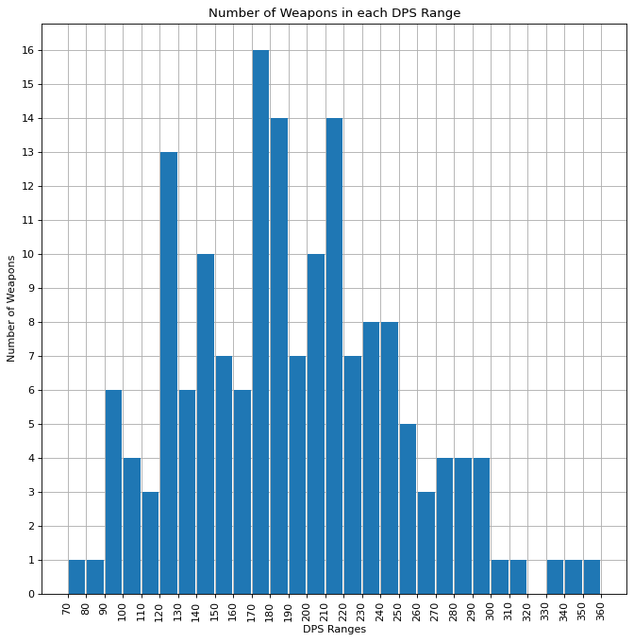
Figure 1
Figure 1: This figure depicts the number of weapons within damage ranges of 10. The greatest number of weapons have a DPS between 170 and 180.

Slide 2
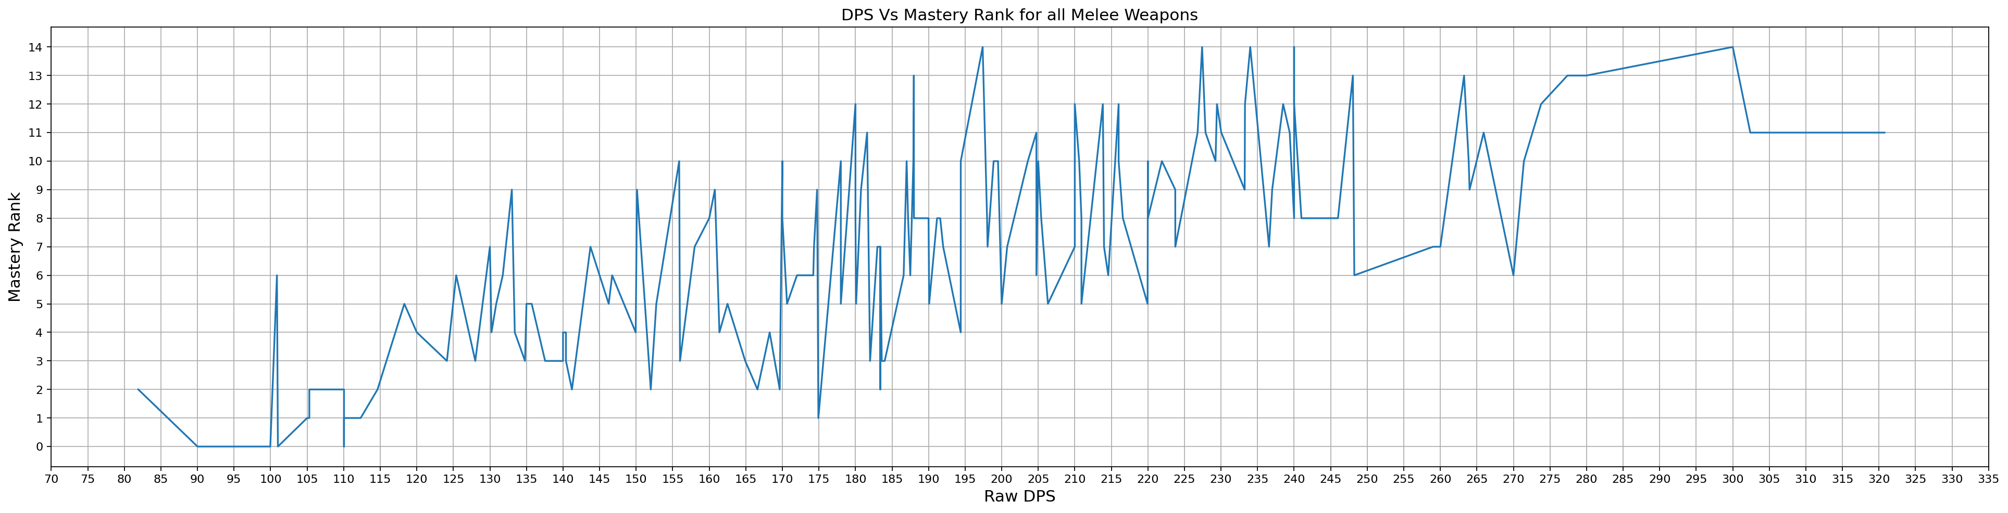
Figure 2
Figure 2: This figure depicts the DPS versus the Mastery Rank of the weapon. It results in the graph being a spiky mess as the DPS does not line up with mastery rank.

Slide 3
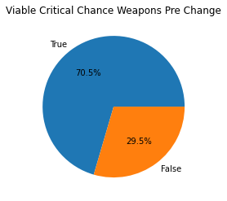
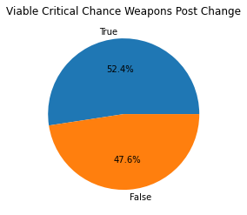
Figure 5
Figure 5: The figure on the left shows the number of weapons that can achieve 100% critical chance before the nerf. The right shows the number of weapons that can achieve 100% critical chance after the nerf.

Slide 4
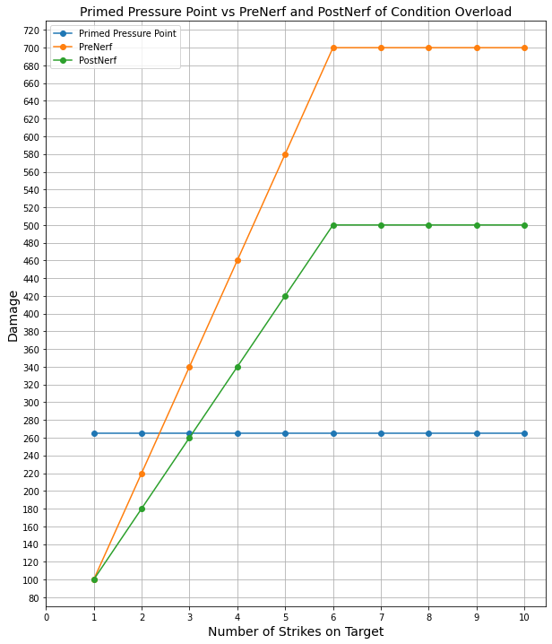
Pressure Point vs Condition Overload
Figure 7: This Figure compares the damage of Condition Overload before and after the nerf with Primed Pressure Point be used as a baseline. Some assumptions are made in this graph first the damage of the weapon is 100. 100 makes it easier to apply the damage changes for example Primed Pressure Point multiplier is 1.65 which results in 165 damage plus the base 100 results in 265 damage. Next it is assumed that the target has zero statuses on them meaning Condition Overload starts at zero. The next assumption is that one unique status is applied after each strike with five being the max number of unique statuses. Five is chosen as most melee weapon can apply five statuses.

Slide 5
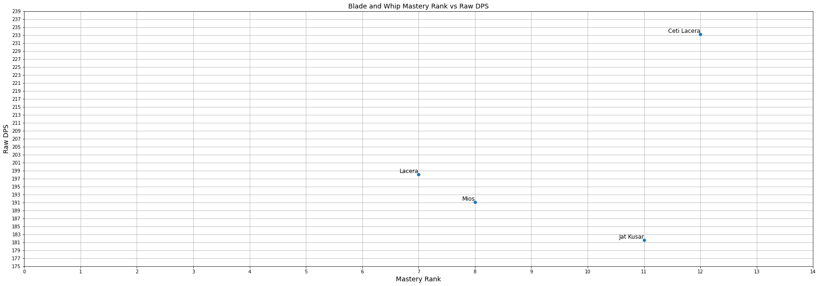
Blade and Whip DPS
This figure shows the Mastery rank of the weapon versus the base DPS of the weapon. Jat Kusar has the lowest base damage. Mios may need more changes to improve it overall damage.

Slide 6
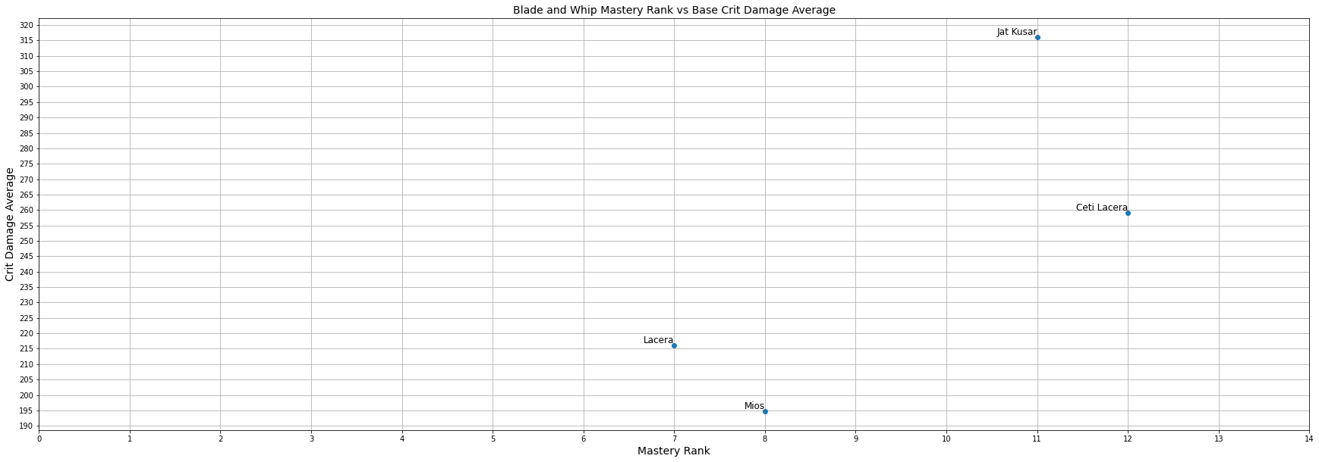
Blade and Whip Crit Damage
This Figure shows the average critical damage versus mastery rank for the weapon. Jat Kusar has the highest critical chance/damage out of the four weapons maybe Ceti Lacera needs a buff.

Slide 7
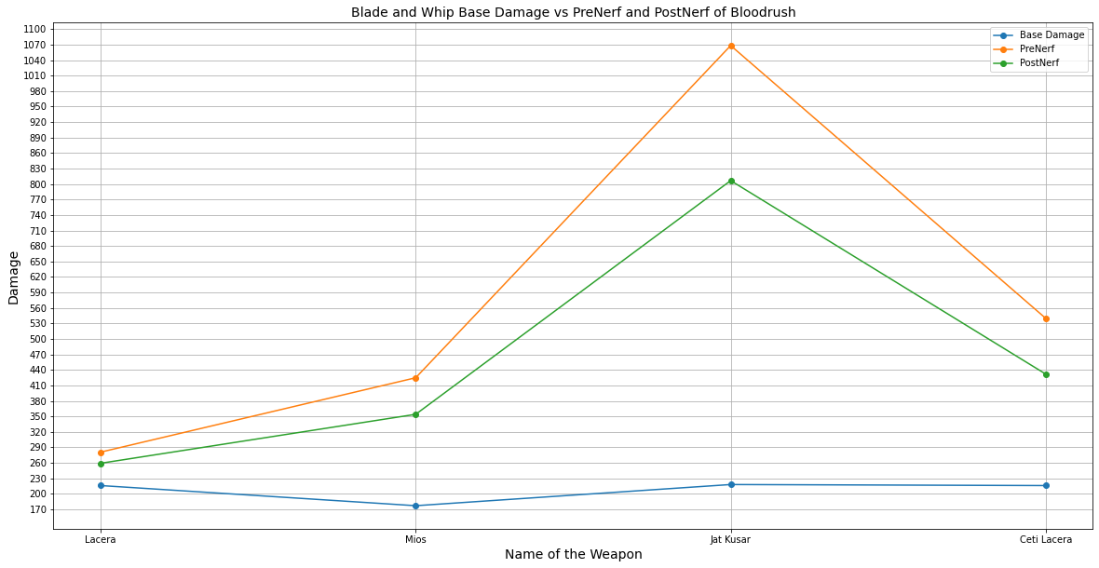
Blade and Whip Blood Rush
This figure shows the base damage, PreNerf critical damage, and PostNerf critical damage of Blade and Whip weapons. The base Damage is the blue line. The yellow line represents PreNerf critical damage, and the green line represents PostNerf critical damage. The names are sorted by Mastery Rank from least to greatest. Blood Rush finally pushes Mios ahead of Lacera in a sense and helps balance the weapons. Ceti Lacera is an upgrade version of Lacera and may need better critical properties.

Slide 8
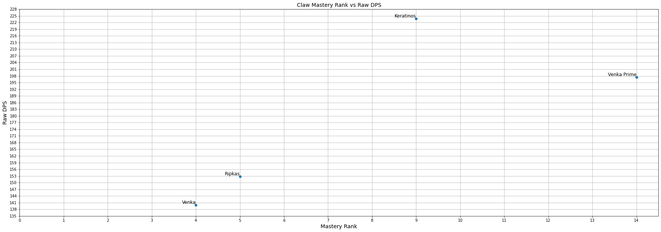
Claws DPS
This figure shows the Mastery rank of the weapon versus the base DPS of the weapon. In terms of base DPS Venka Prime or Keratinos are currently out of line.

Slide 9
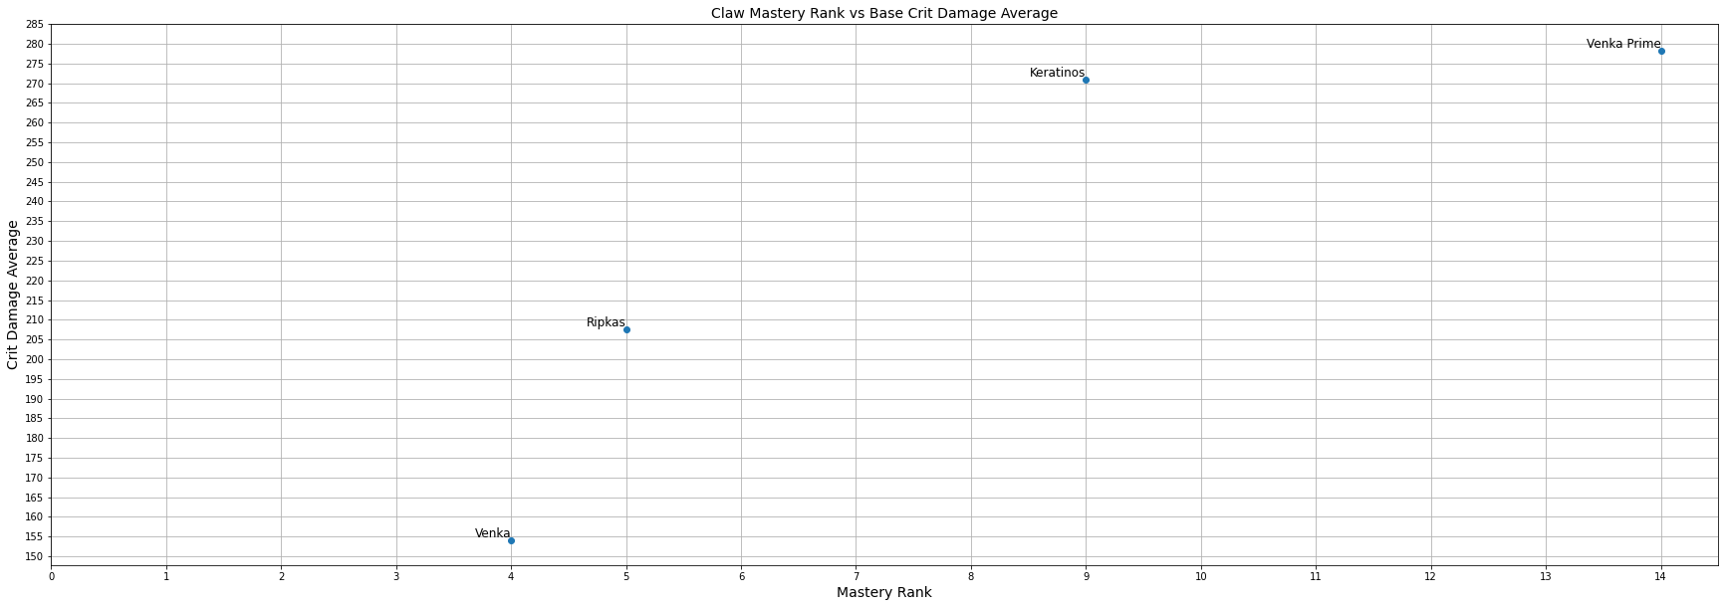
Claws Crit Damage
This Figure shows the average critical damage versus mastery rank for the weapon. The Critical Chance/Damage of these weapons show they are more appropriately balanced. No changes may be needed.

Slide 10
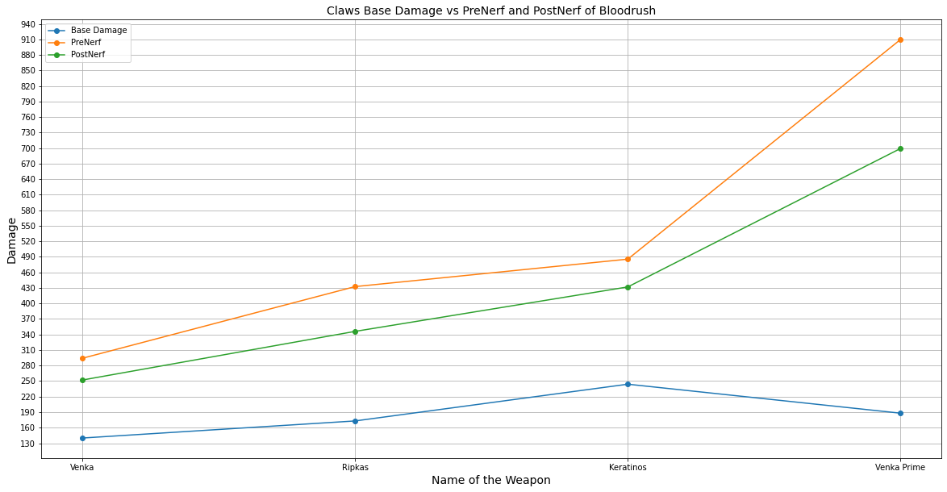
Claws Blood Rush
This figure shows the base damage, PreNerf critical damage, and PostNerf critical damage of Claw weapons. The base Damage is the blue line. The yellow line represents PreNerf critical damage, and the green line represents PostNerf critical damage. The names are sorted by Mastery Rank from least to greatest. It looks like the weapons were balance with Critical stats in mind as the damage increase as Mastery rank goes up.

Slide 11
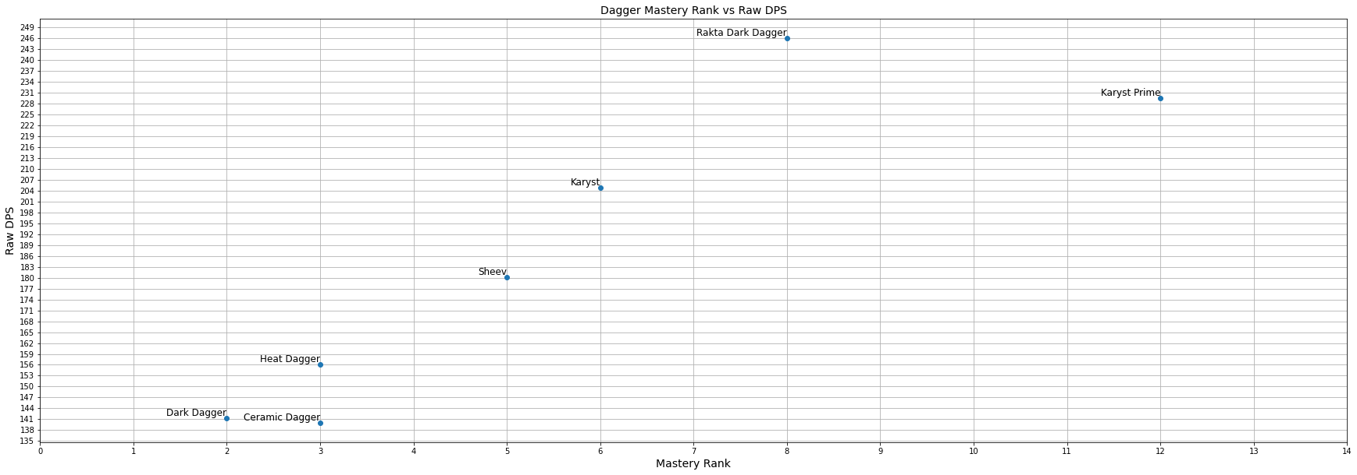
Dagger DPS
This figure shows the Mastery rank of the weapon versus the base DPS of the weapon. The Ceramic Dagger may need some help as it is currently outclassed by the Heat Dagger.

Slide 12
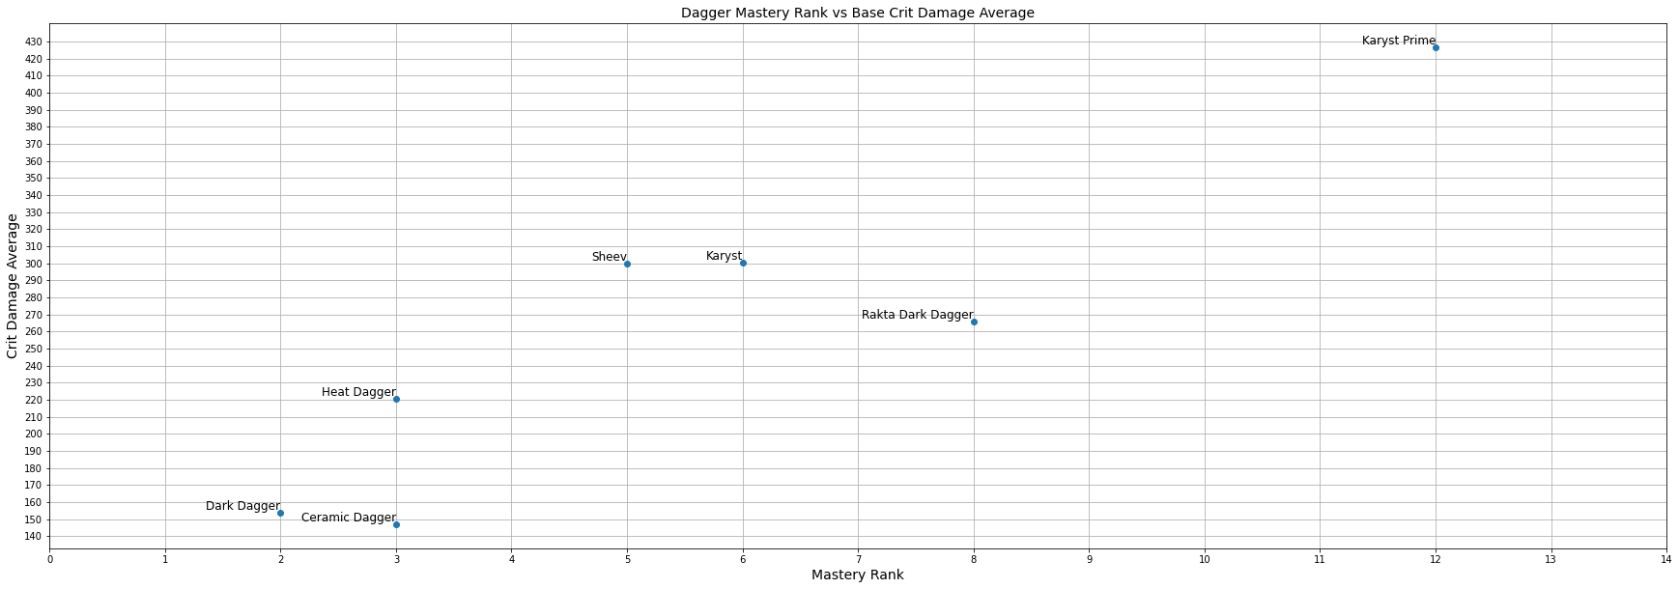
Dagger Crit Damage
This Figure shows the average critical damage versus mastery rank for the weapon. The Rakta Dark Dagger and Ceramic Dagger may need more help.

Slide 13
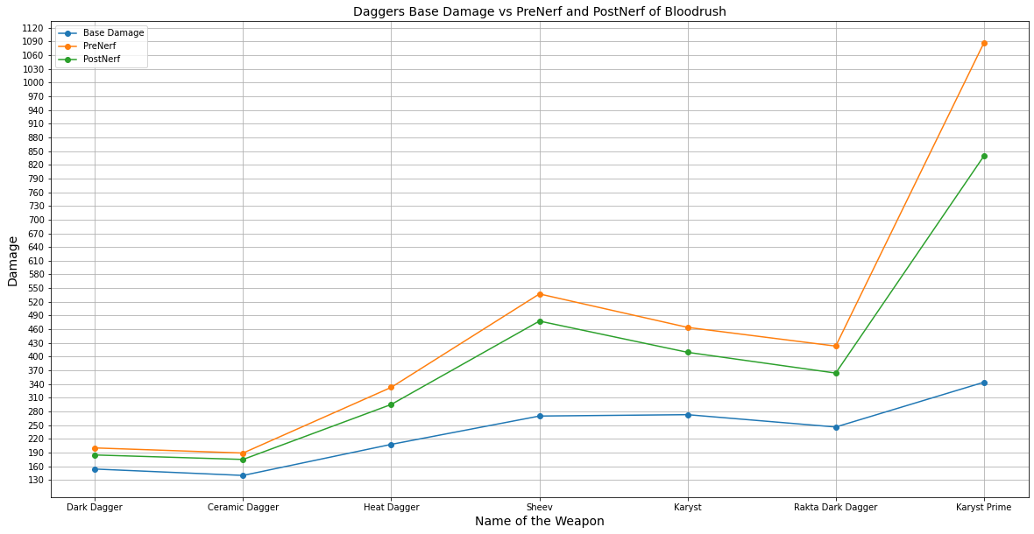
Dagger Blood Rush
This figure shows the base damage, PreNerf critical damage, and PostNerf critical damage of dagger weapons. The base Damage is the blue line. The yellow line represents PreNerf critical damage, and the green line represents PostNerf critical damage. The names are sorted by Mastery Rank from least to greatest. It is interesting that the Ceramic Dagger is not really affected by the change were as Karyst Prime takes a huge hit in damage.

Slide 14
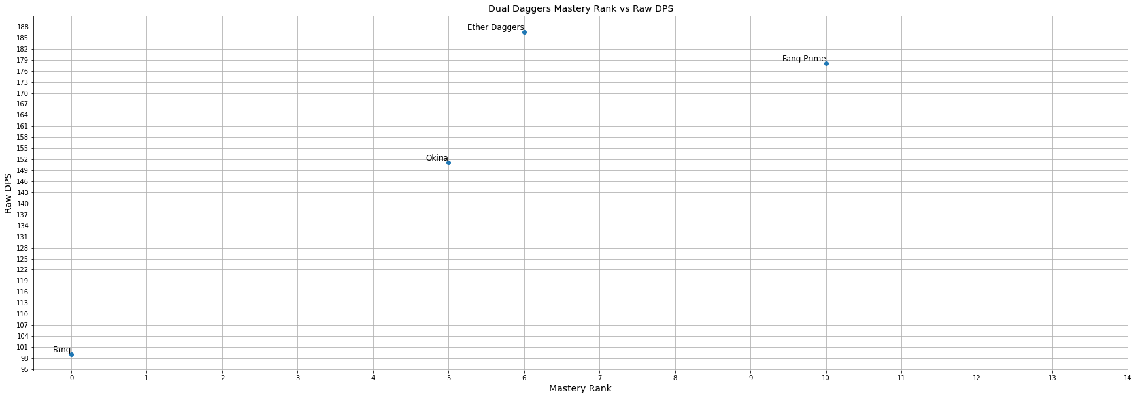
Dual Daggers DPS
This figure shows the Mastery rank of the weapon versus the base DPS of the weapon. Base DPS wise it looks like Ether Daggers are on top maybe Fang Prime need more damage. Overall the damage increases as mastery rank increases.

Slide 15
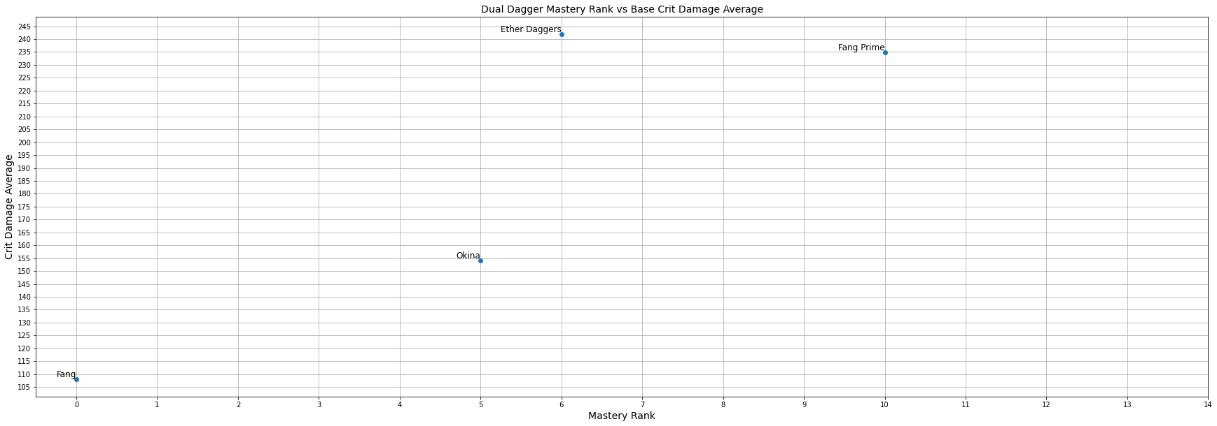
Dual Daggers Crit Damage
This Figure shows the average critical damage versus mastery rank for the weapon. Base critical stats wise it looks like Ether Daggers still beat Fang Prime.

Slide 16
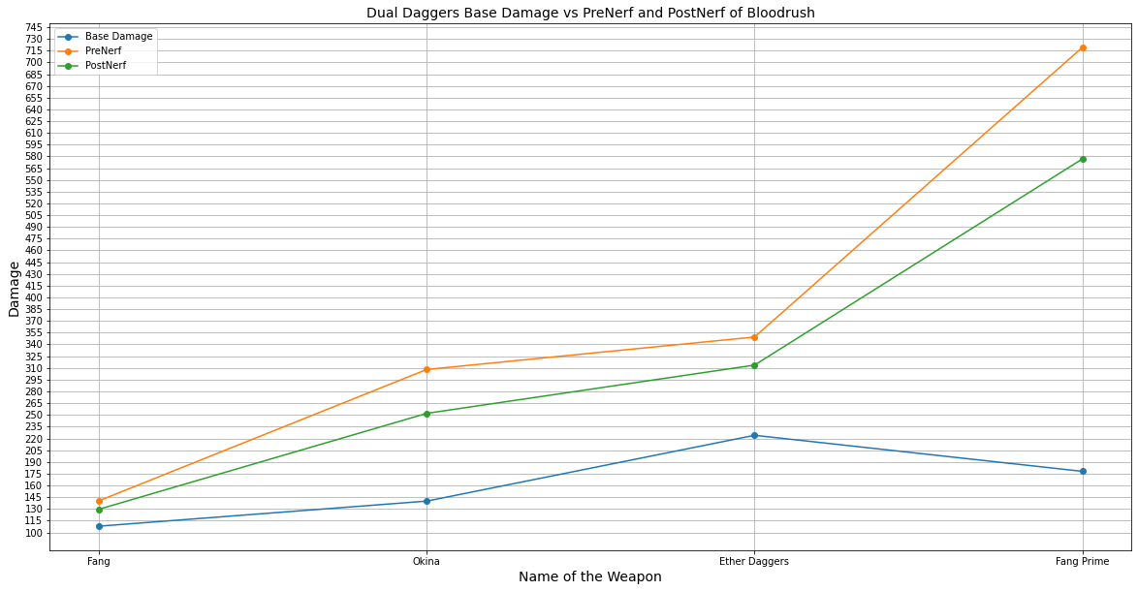
Dual Daggers Blood Rush
This figure shows the base damage, PreNerf critical damage, and PostNerf critical damage of Dual Daggers weapons. The base Damage is the blue line. The yellow line represents PreNerf critical damage, and the green line represents PostNerf critical damage. The names are sorted by Mastery Rank from least to greatest. Blood Rush once again balances the damage of the weapons. Fang Prime must not have enough critical chance without blood rush to beat Ether daggers normally.

Slide 17
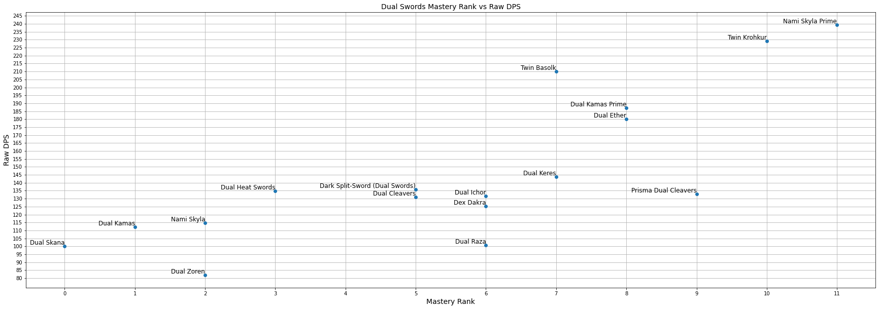
Dual Swords DPS
This figure shows the Mastery rank of the weapon versus the base DPS of the weapon. Dual Swords are interesting how spread out the DPS is in each Mastery Rank. Ideally the weapons DPS should be overlapping. Dual Zoren and Dual Raza both got the short end of the stick.

Slide 18
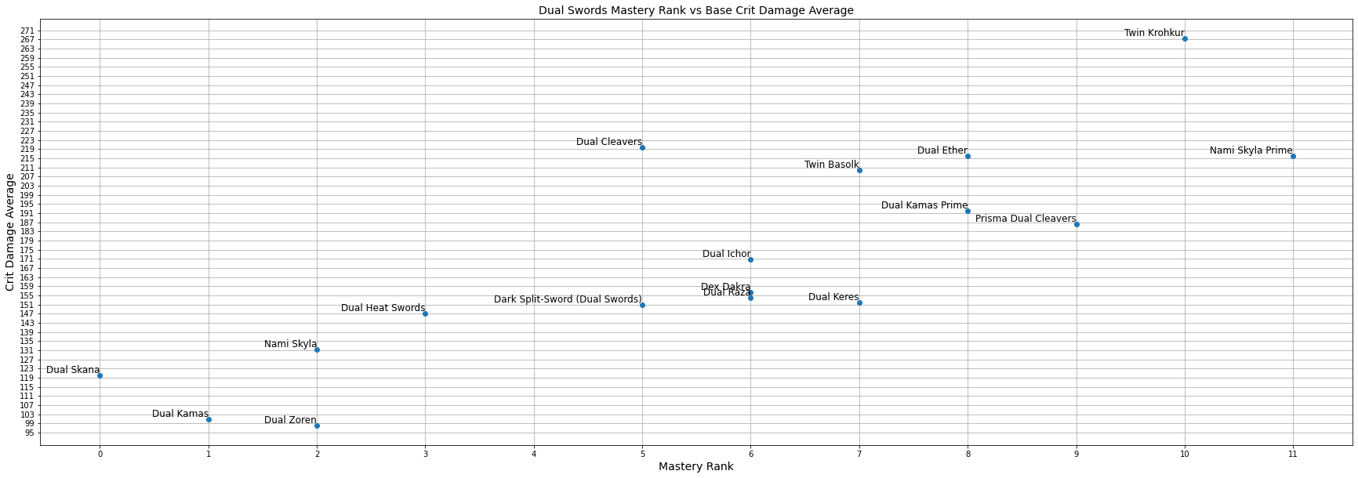
Dual Swords Crit Damage
This Figure shows the average critical damage versus mastery rank for the weapon. Base critical stats do not balance out the weapons. Dual Zoren may really need a buff or a lower Mastery Rank. Any overlap will be fixed in the next update.

Slide 19
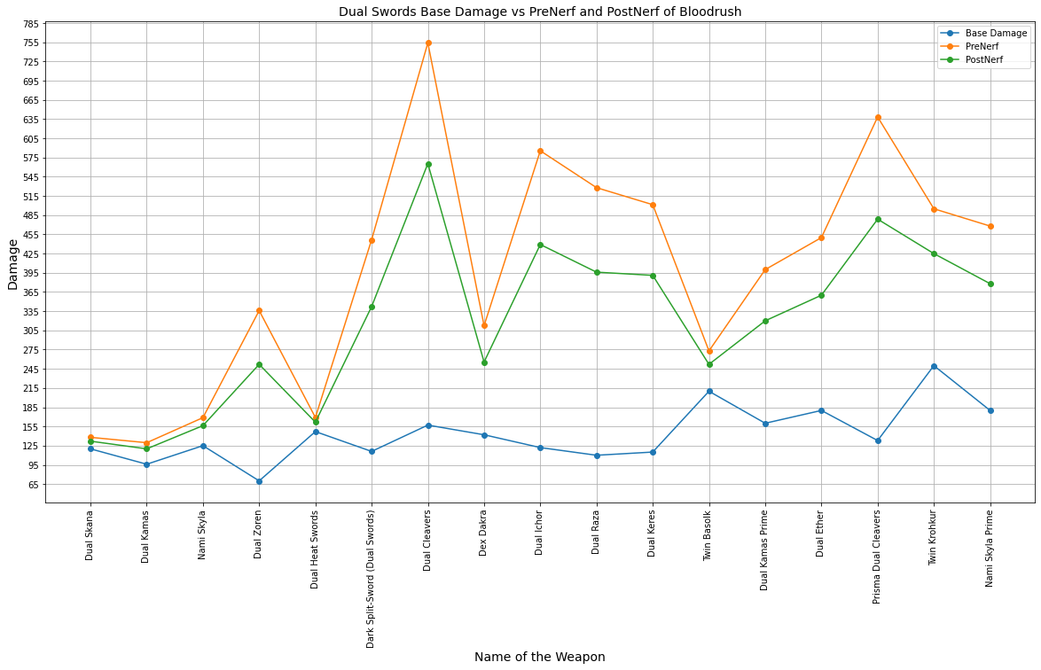
Dual Swords Blood Rush
This figure shows the base damage, PreNerf critical damage, and PostNerf critical damage of Dual Swords weapons. The base Damage is the blue line. The yellow line represents PreNerf critical damage, and the green line represents PostNerf critical damage. The names are sorted by Mastery Rank from least to greatest. Dual Zoren finally escape from being worse than Dual Skana. Dual Cleavers may be to strong as there damage is high at its mastery rank. Dual Cleavers are stronger than there Prisma upgrade in terms of critical stats.

Slide 20
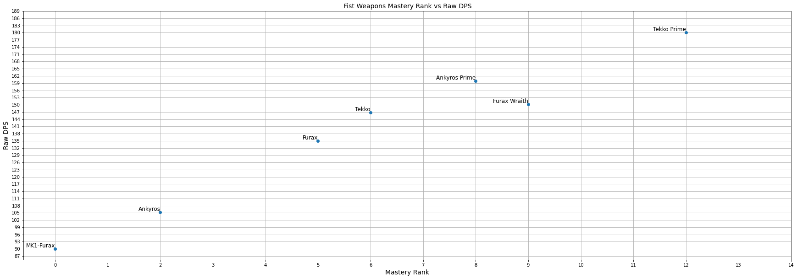
Fist DPS
This figure shows the Mastery rank of the weapon versus the base DPS of the weapon. Fist weapons are mostly balanced in terms of raw DPS except Furax Wraith which may need a slight base damage boost.

Slide 21
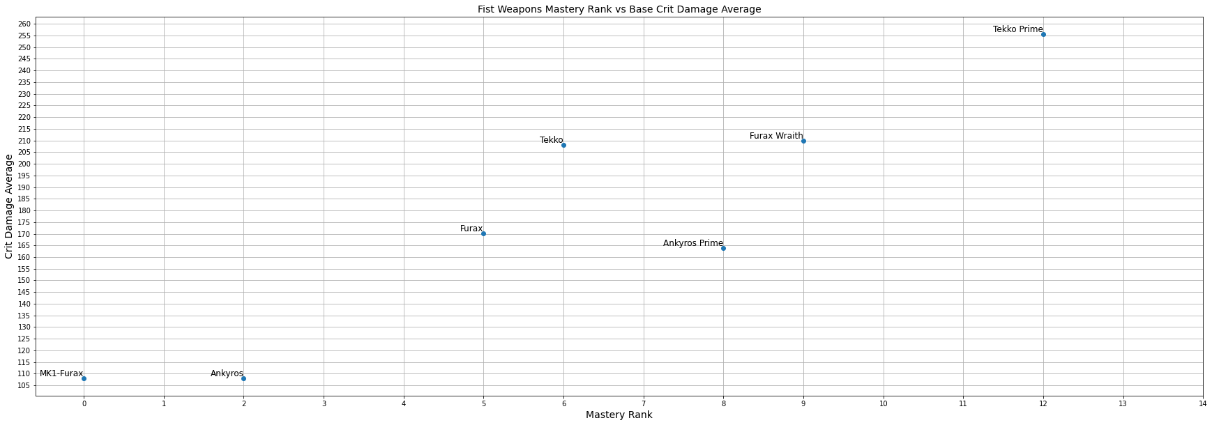
Fist Crit Damage
This Figure shows the average critical damage versus mastery rank for the weapon. Ankyros Prime base critical stats are lacking overall damage increase as mastery rank increases.

Slide 22
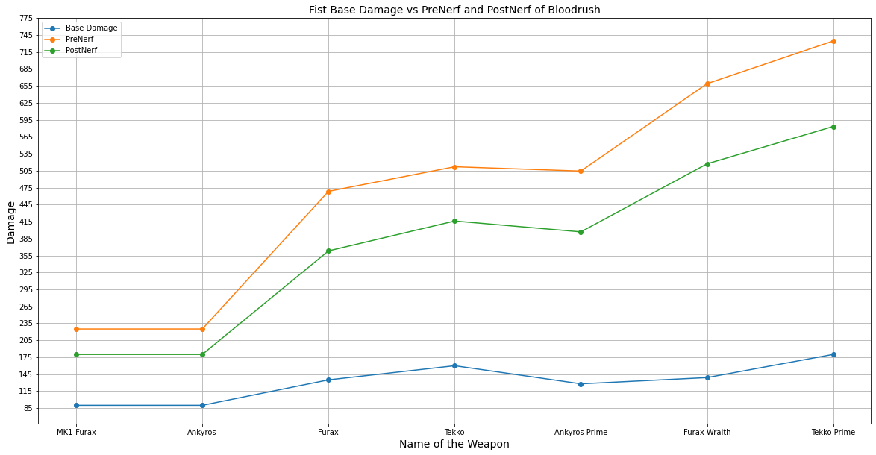
Fist Blood Rush
This figure shows the base damage, PreNerf critical damage, and PostNerf critical damage of Fist weapons. The base Damage is the blue line. The yellow line represents PreNerf critical damage, and the green line represents PostNerf critical damage. The names are sorted by Mastery Rank from least to greatest. Ankyros Prime may need a slight boost in critical stats to be balanced for it mastery rank. Overall Fist weapons seem balanced by mastery rank.

Slide 23
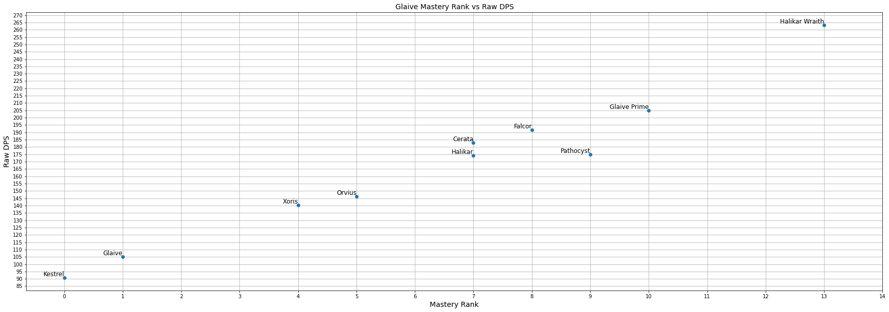
Glaive DPS
This figure shows the Mastery rank of the weapon versus the base DPS of the weapon. Glaives seem to be mostly balance with a couple of exeptions.

Slide 24
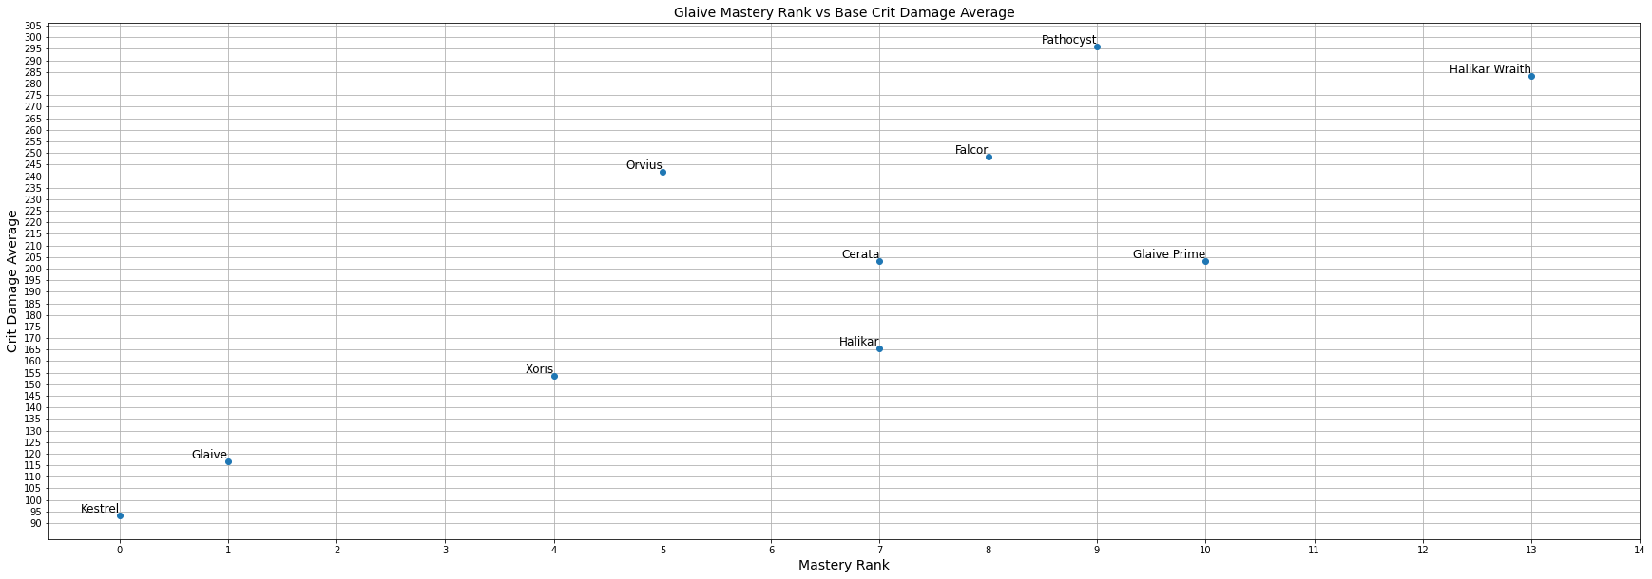
Glaive Crit Damage
This Figure shows the average critical damage versus mastery rank for the weapon. When Critical stats are taken into account the balance changes significantly.

Slide 25
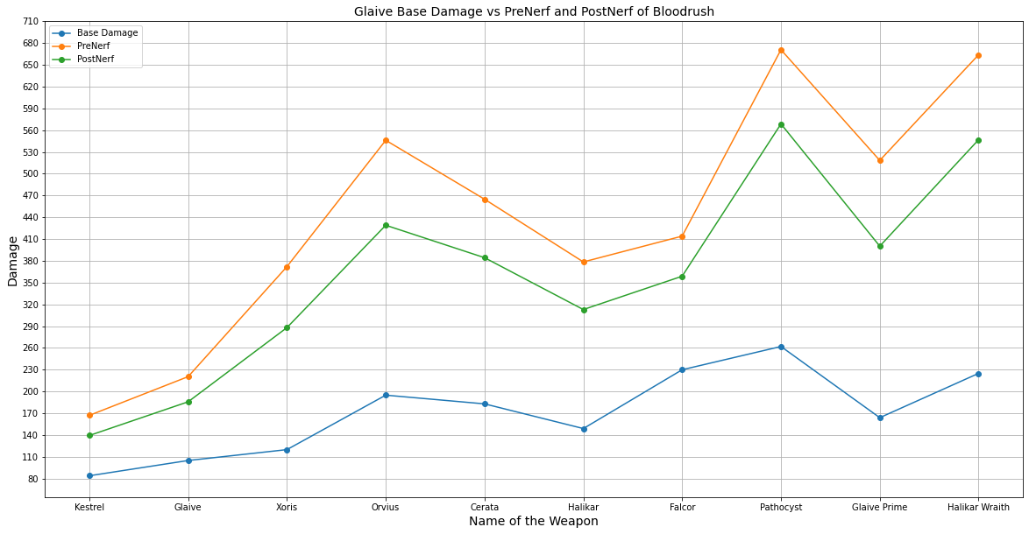
Glaive Blood Rush
This figure shows the base damage, PreNerf critical damage, and PostNerf critical damage of Glaive weapons. The base Damage is the blue line. The yellow line represents PreNerf critical damage, and the green line represents PostNerf critical damage. The names are sorted by Mastery Rank from least to greatest. Some of the weapons may need changes based on critical stats as some weapons fall behind others like Glaive Prime.

Slide 26
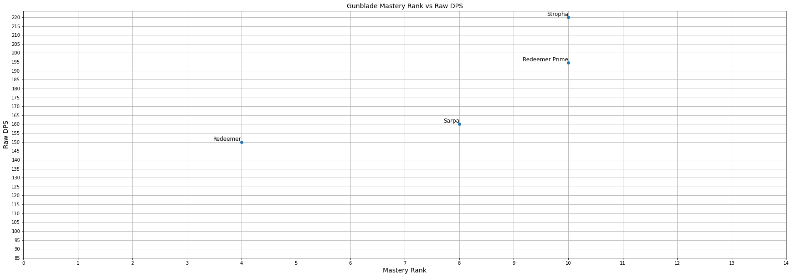
Gunblade DPS
This figure shows the Mastery rank of the weapon versus the base DPS of the weapon. It is interesting that the weapons DPS is like exponential curve.

Slide 27
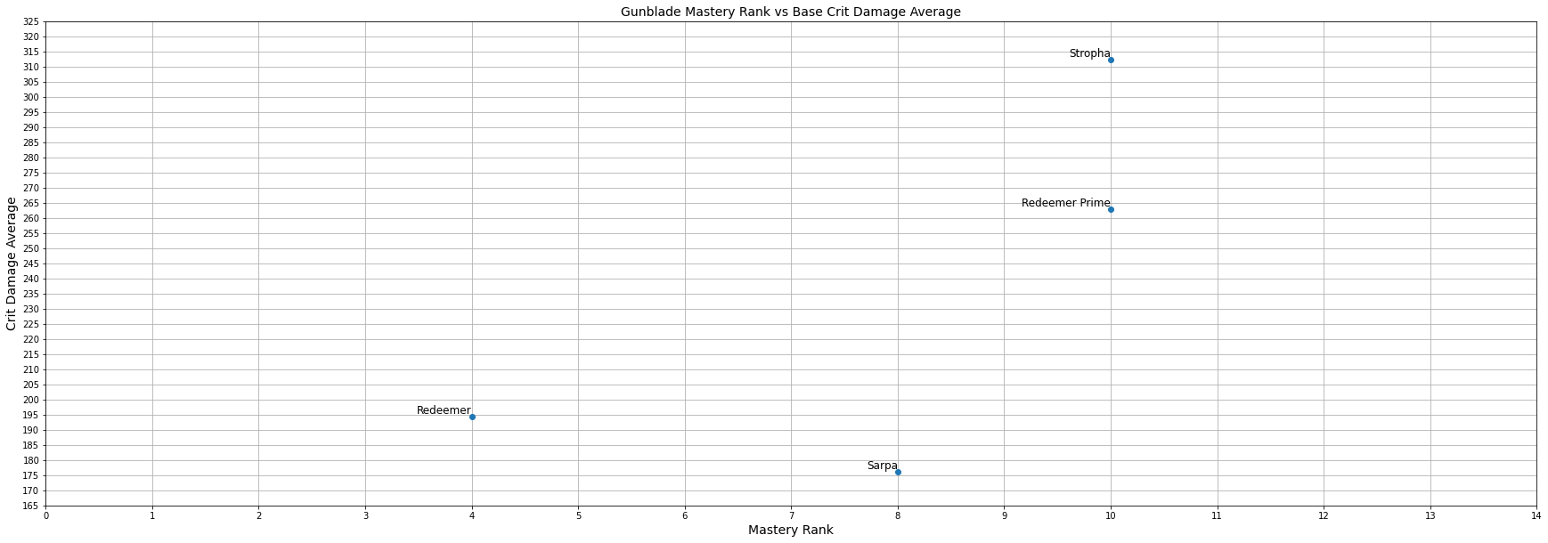
Gunblade Crit Damage
This Figure shows the average critical damage versus mastery rank for the gunblade weapons. Sarpa’s base critical stats are a little lacking and may need a change.

Slide 28
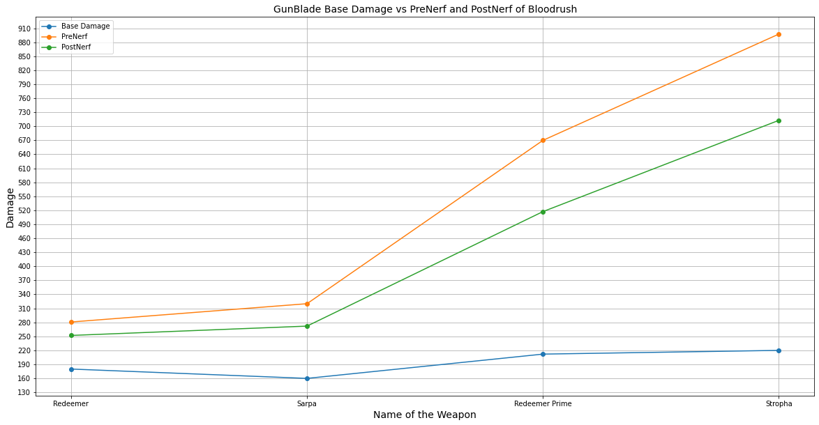
Gunblade Blood Rush
This figure shows the base damage, PreNerf critical damage, and PostNerf critical damage of gunblade weapons. The base Damage is the blue line. The yellow line represents PreNerf critical damage, and the green line represents PostNerf critical damage. The names are sorted by Mastery Rank from least to greatest. Blood Rush once again brings the weapons more in line. Stropha may need to be placed at a higher Mastery Rank.

Slide 29
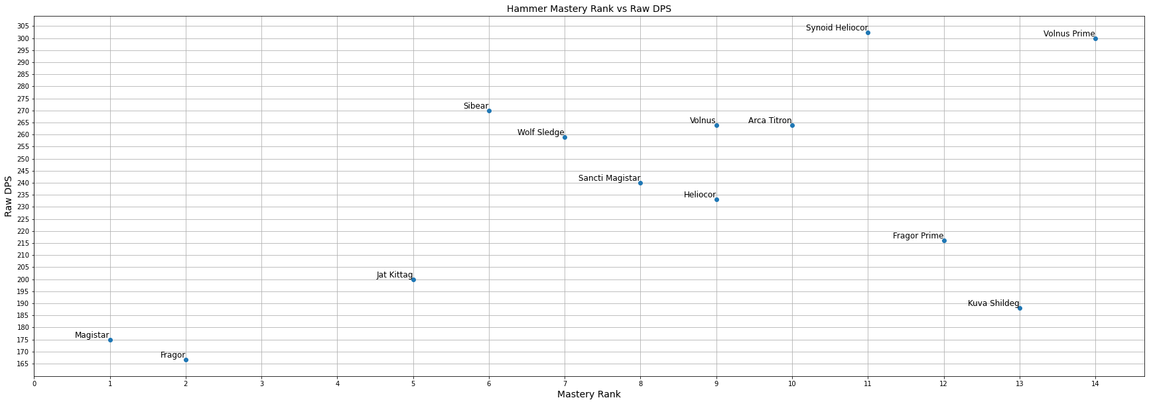
Hammer DPS
This figure shows the Mastery rank of the weapon versus the base DPS of the weapon. According to this graph, many of the hammers need a damage tweak. Fragor is an excellent example of a weapon needing a buff.

Slide 30
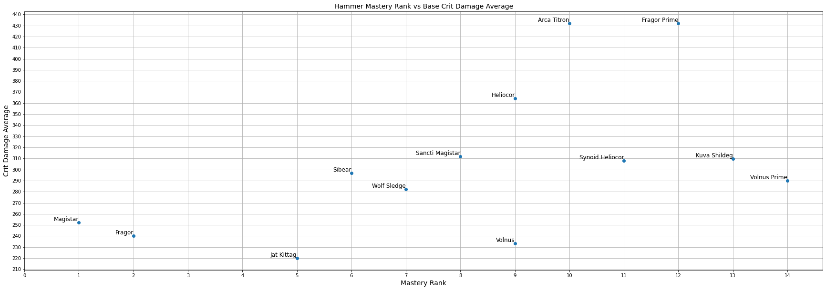
Hammer Crit Damage
This Figure shows the average critical damage versus mastery rank for the weapon. Fragor prime and the Arca Titron heavily rely on critical damage, while the Jat Kittag suffers from low critical chance or damage.

Slide 31
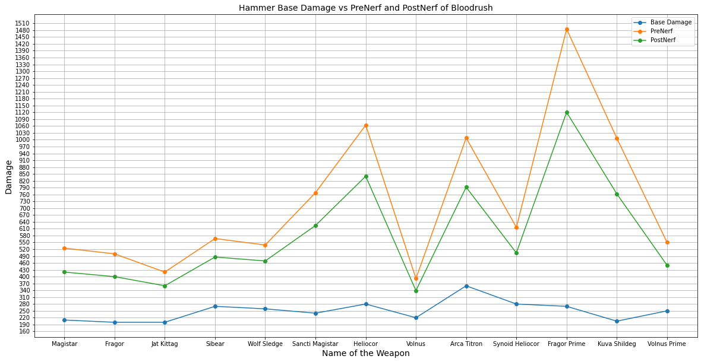
Hammer Blood Rush
This figure shows the base damage, PreNerf critical damage, and PostNerf critical damage of hammer weapons. The base Damage is the blue line. The yellow line represents PreNerf critical damage, and the green line represents PostNerf critical damage. The names are sorted by Mastery Rank from least to greatest. Fragor Prime benefits heavily from extra critical damage. It also suffered from a 25% decrease in damage after the nerf.

Slide 32
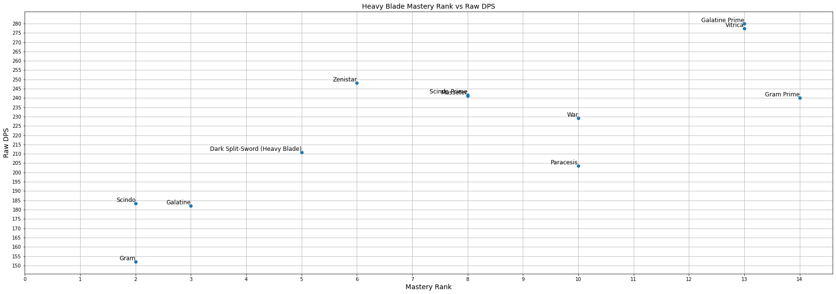
Heavy Blade DPS
This figure shows the Mastery rank of the weapon versus the base DPS of the weapon. Damage does not seem to be strongly connected to mastery rank. Future versions of the graph will not have overlap. The two that are overlapping are Scindo Prime and the Masseter.

Slide 33
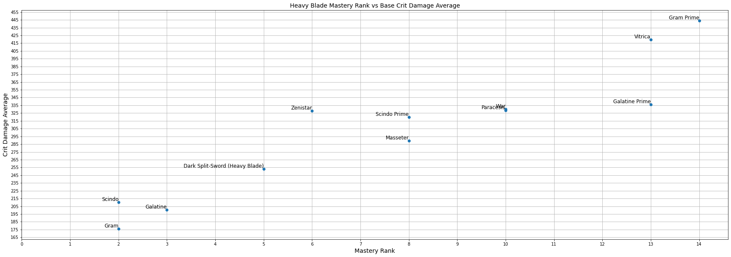
Heavy Blade Crit Damage
This Figure shows the average critical damage versus mastery rank for the weapon. When Critical stats are considered the weapons line up more. War and Paracesis overlap will be fixed in a future version.

Slide 34
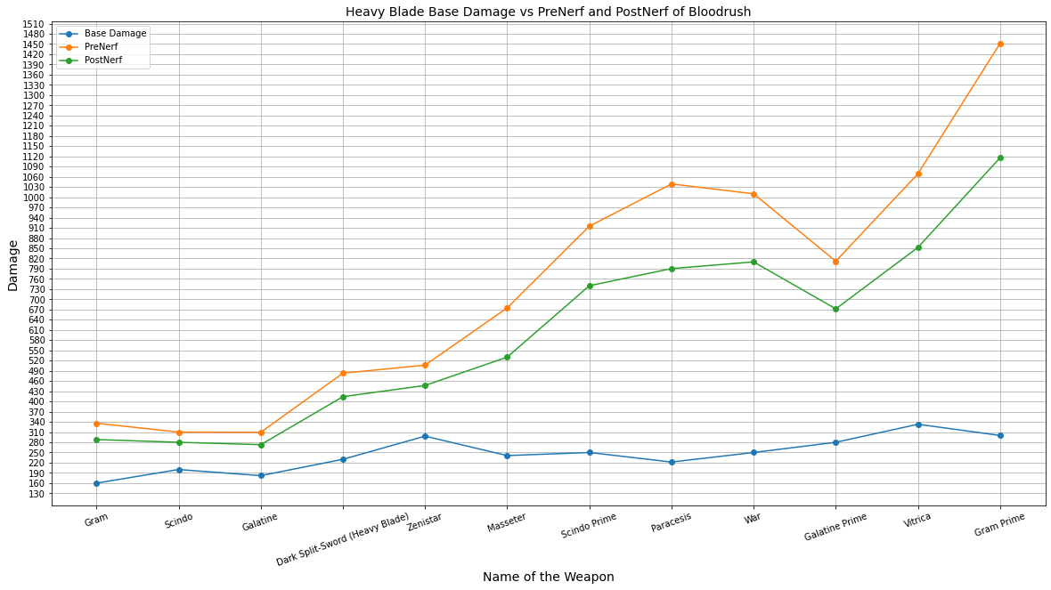
Heavy Blade Blood Rush
This figure shows the base damage, PreNerf critical damage, and PostNerf critical damage of Heavy Blade weapons. The base Damage is the blue line. The yellow line represents PreNerf critical damage, and the green line represents PostNerf critical damage. The names are sorted by Mastery Rank from least to greatest. Both versions of Galatine need some more help in terms of their critical stats.

Slide 35
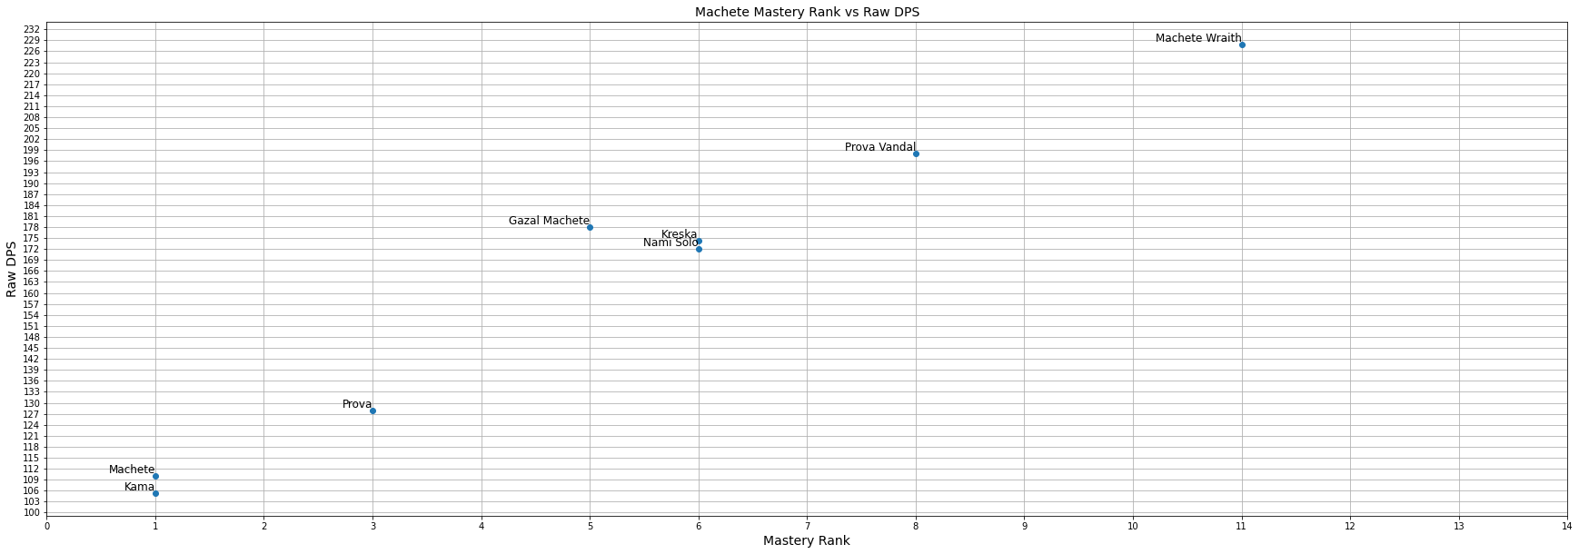
Machete DPS
This figure shows the Mastery rank of the weapon versus the base DPS of the weapon. According to this figure Kreska and Nami Solo may need a damage increase to be more in line with the other weapons.

Slide 36
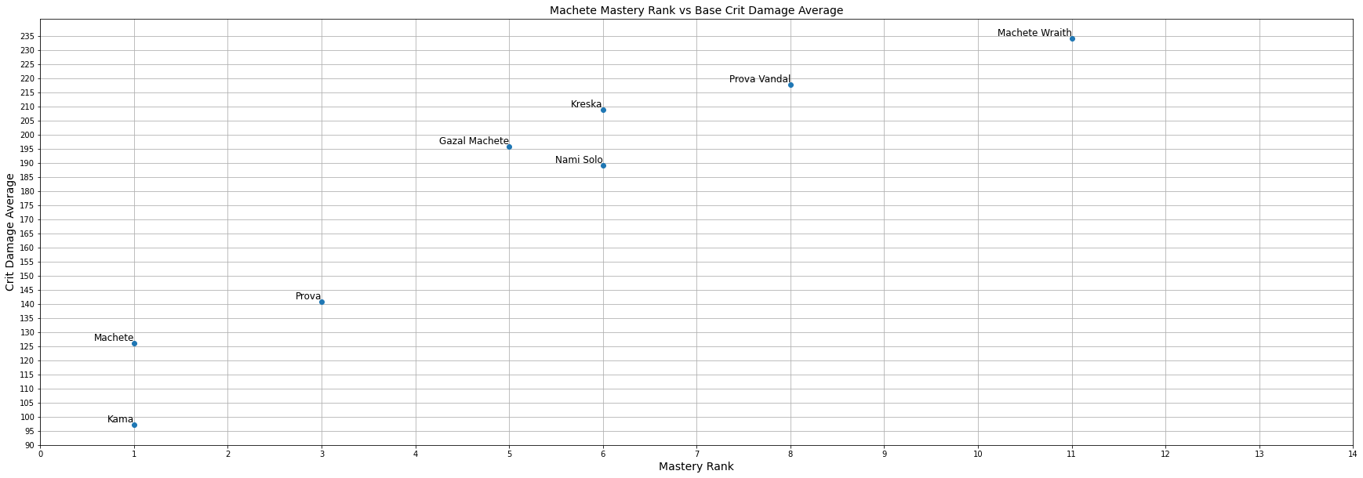
Machete Crit Damage
This Figure shows the average critical damage versus mastery rank for the weapon. Both the Kama and Nami Solo should both be considered for buffs.

Slide 37
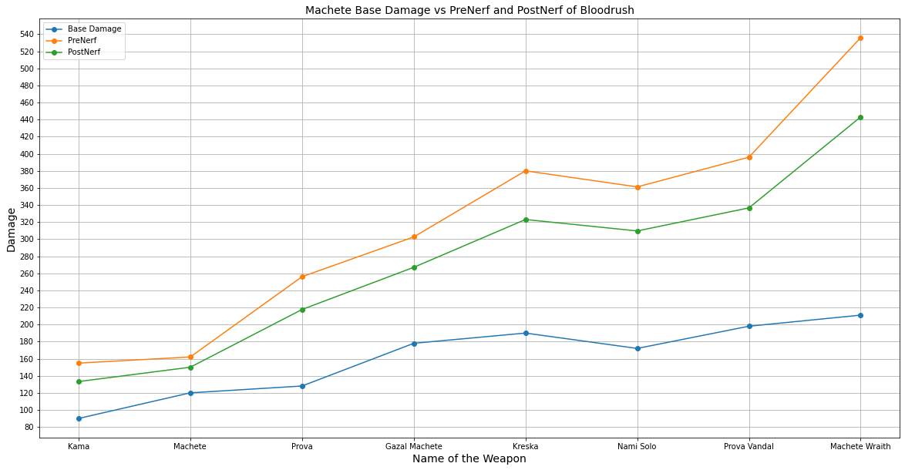
Machete Blood Rush
This figure shows the base damage, PreNerf critical damage, and PostNerf critical damage of Machete weapons. The base Damage is the blue line. The yellow line represents PreNerf critical damage, and the green line represents PostNerf critical damage. The names are sorted by Mastery Rank from least to greatest. Nami Solo and Kama should be considered for buffs to be more inline with the other weapons.

Slide 38
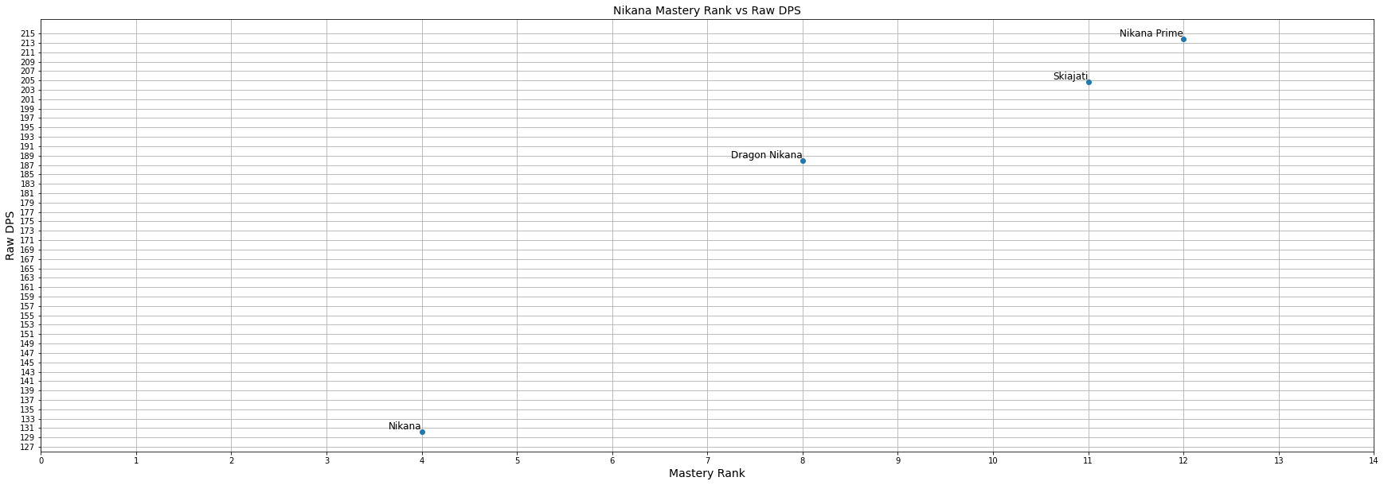
Nikana DPS
This figure shows the Mastery rank of the weapon versus the base DPS of the weapon. The four Nikana form a decently straight line no real changes required.

Slide 39
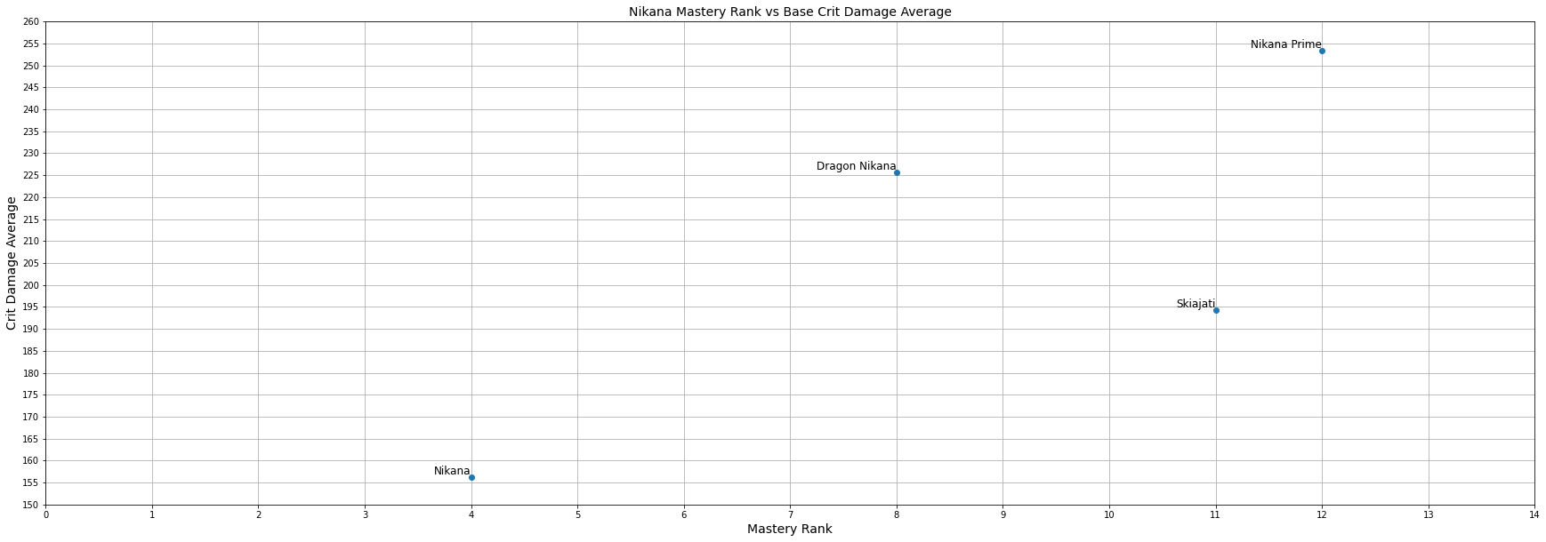
Nikana Crit Damage
This Figure shows the average critical damage versus mastery rank for the weapon. Skiajati Critical stats may be a little low for its mastery rank.

Slide 40
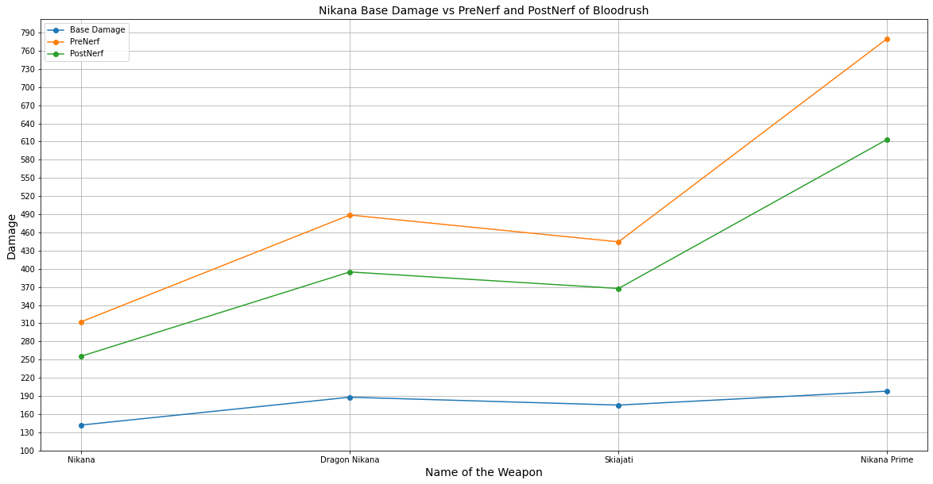
Nikana Blood Rush
This figure shows the base damage, PreNerf critical damage, and PostNerf critical damage of Nikana weapons. The base Damage is the blue line. The yellow line represents PreNerf critical damage, and the green line represents PostNerf critical damage. The names are sorted by Mastery Rank from least to greatest. Skiajati critical stats are a little low for its master rank.

Slide 41
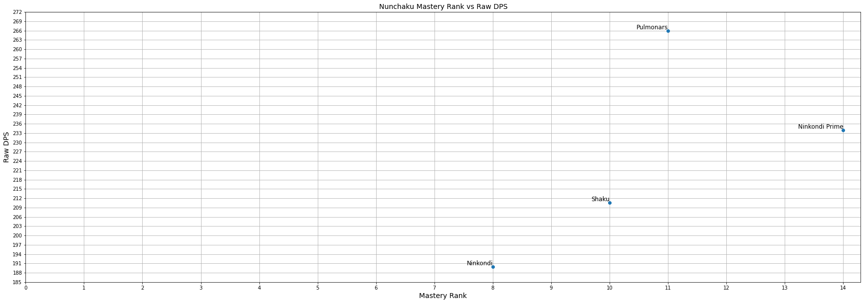
Nunchaku DPS
This figure shows the Mastery rank of the weapon versus the base DPS of the weapon. Pulmonars has very high base DPS and should be considered for changes.

Slide 42
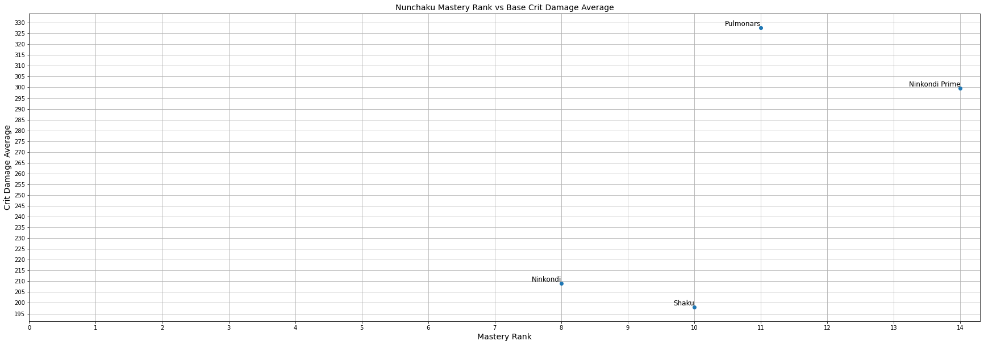
Nunchaku Crit Damage
This Figure shows the average critical damage versus mastery rank for the weapon. Shaku critical stats are not where they should be and Pulmonars does not seem to master rank 11 weapon for nunchaku.

Slide 43
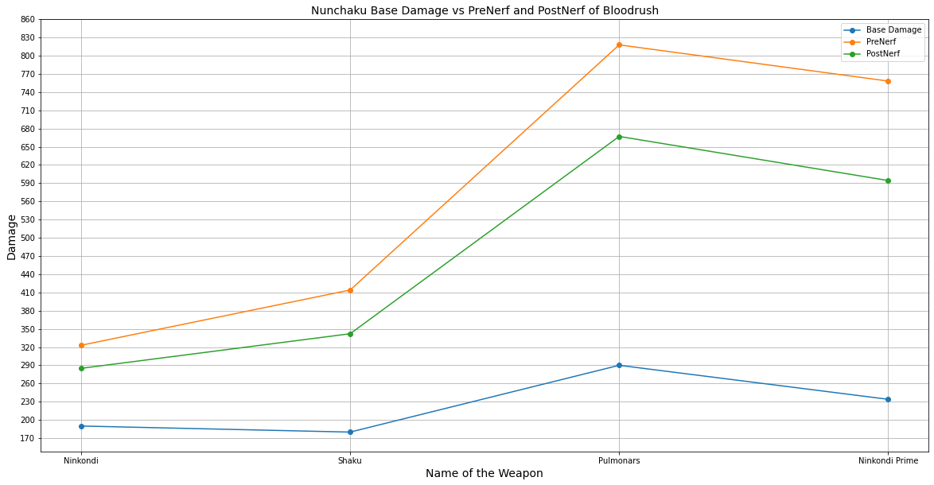
Nunchaku Blood Rush
This figure shows the base damage, PreNerf critical damage, and PostNerf critical damage of Nunchaku weapons. The base Damage is the blue line. The yellow line represents PreNerf critical damage, and the green line represents PostNerf critical damage. The names are sorted by Mastery Rank from least to greatest. Ninkondi Prime may need a damage buff.

Slide 44
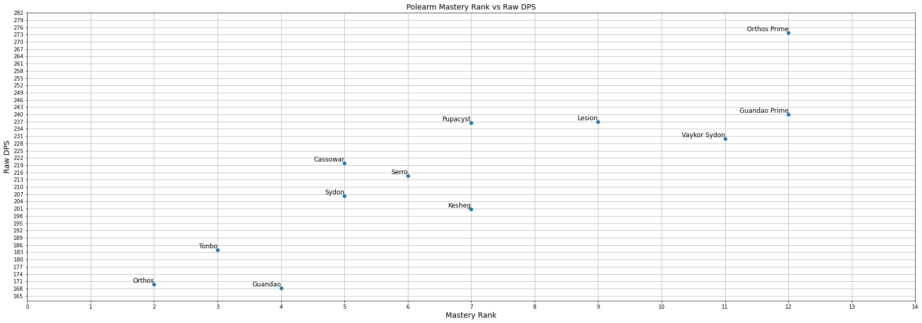
Polearm DPS
This figure shows the Mastery rank of the weapon versus the base DPS of the weapon. The graph forms sort of line, but there are a few outliers that may need some buffs.

Slide 45
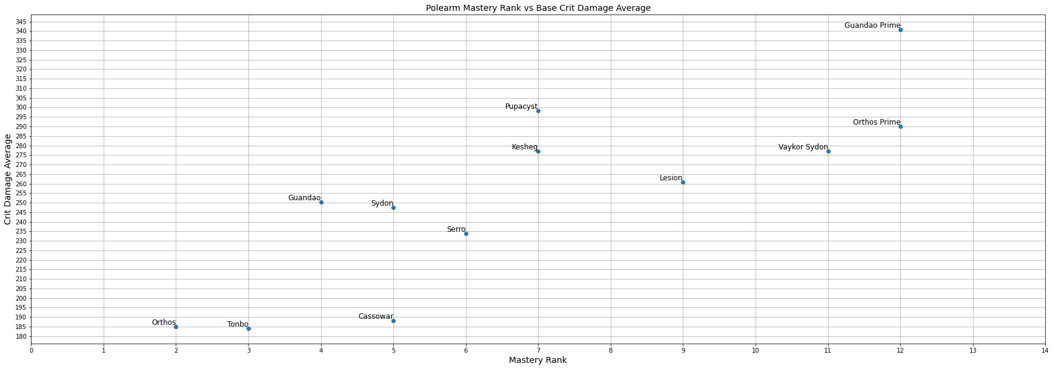
Polearm Crit Damage
This Figure shows the average critical damage versus mastery rank for the weapon. Note how Guandao Prime and Orthos Prime swapped spots for which did more damage. Cassowar and Sydon also swapped spots.

Slide 46
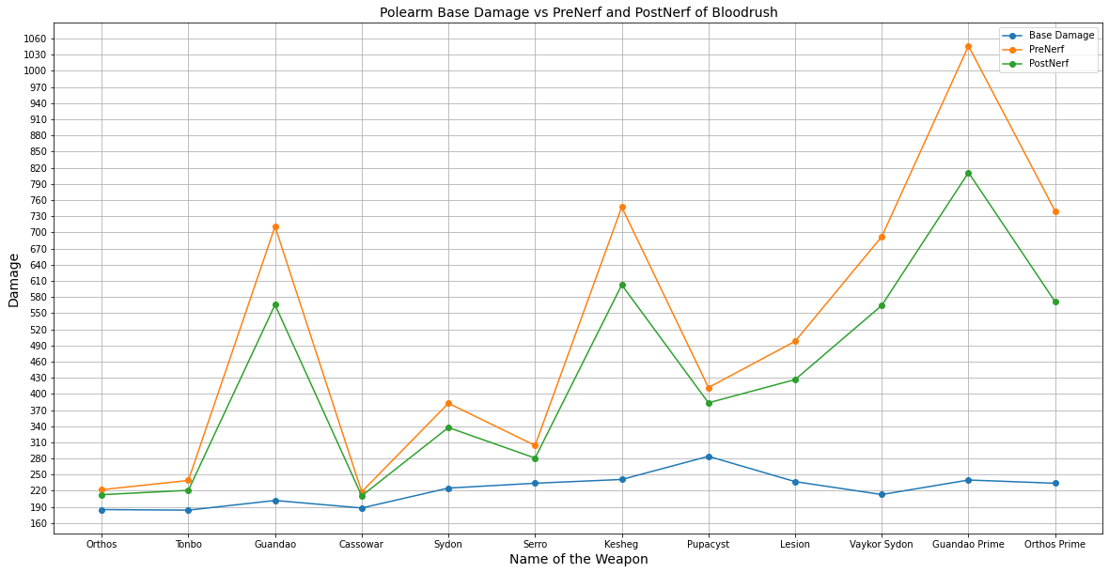
Polearm Blood Rush
This figure shows the base damage, PreNerf critical damage, and PostNerf critical damage of Polearm weapons. The base Damage is the blue line. The yellow line represents PreNerf critical damage, and the green line represents PostNerf critical damage. The names are sorted by Mastery Rank from least to greatest. Both Guandau varients benefit greatly from blood rush as well as Kesheg.

Slide 47
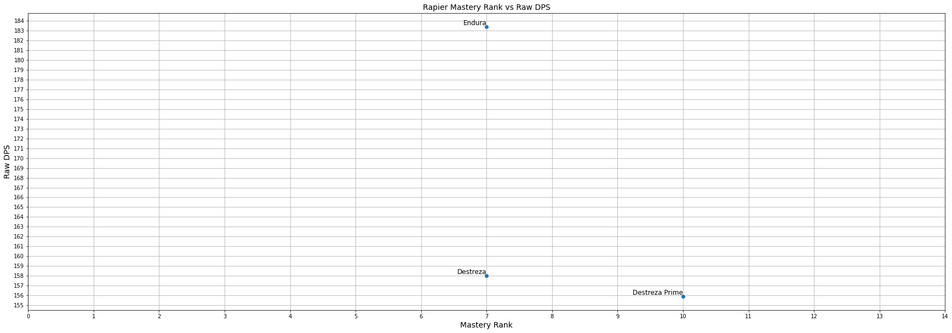
Rapier DPS
This figure shows the Mastery rank of the weapon versus the base DPS of the weapon. It is interesting that the Prime variant of Destreza does less damage than the base weapon.

Slide 48
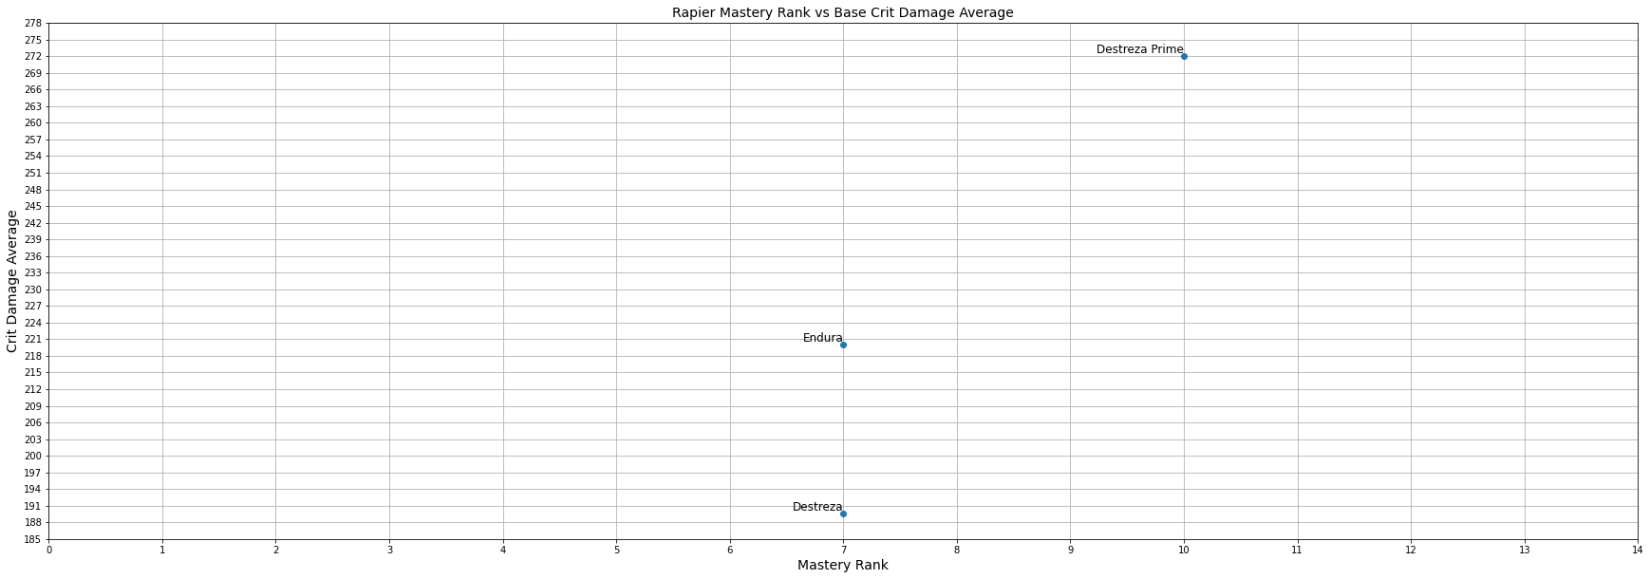
Rapier Crit Damage
This Figure shows the average critical damage versus mastery rank for the weapon. When critical stats are taken into account the prime variant of Destreza far outclasses the regular variant.

Slide 49
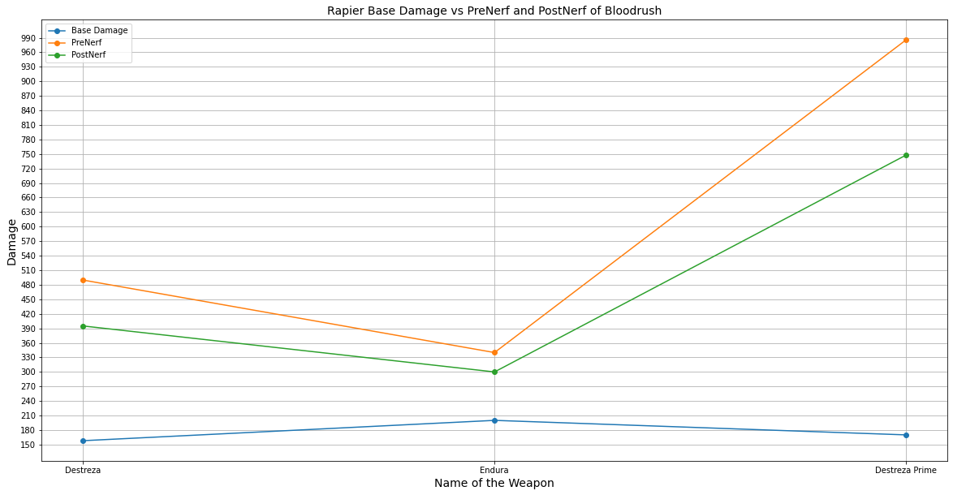
Rapier Blood Rush
This figure shows the base damage, PreNerf critical damage, and PostNerf critical damage of Rapier weapons. The base Damage is the blue line. The yellow line represents PreNerf critical damage, and the green line represents PostNerf critical damage.The names are sorted by Mastery Rank from least to greatest. DE tends to balance weapons around critical or status chance Endura so happens to be a status weapon which is why regular Destreza does more damage with Blood rush.

Slide 50

Scythe DPS
This figure shows the Mastery rank of the weapon versus the base DPS of the weapon. Base Damage wise Caustacyst wins and seems to be over tuned for mastery rank 70.

Slide 51

Scythe Crit Damage
This Figure shows the average critical damage versus mastery rank for Scythe weapons. Both Hate and Reaper Prime benefited from critical stats. Random fact Reaper Prime still does not have a regular version and it is one of the first prime weapons released.

Slide 52

Scythe Blood Rush
This figure shows the base damage, PreNerf critical damage, and PostNerf critical damage of Scythe weapons. The base Damage is the blue line. The yellow line represents PreNerf critical damage, and the green line represents PostNerf critical damage.The names are sorted by Mastery Rank from least to greatest. Blood Rush helps close the divide between Hate and Reaper Prime, but not as much after the nerf.

Slide 53

Sparring DPS
This figure shows the Mastery rank of the weapon versus the base DPS of the weapon. Another chart with an exponential curve rather than a line.

Slide 54

Sparring Crit Damage
This Figure shows the average critical damage versus mastery rank for sparring weapons. Both Korrudo and Kogake Prime do better with critical stats leaving Prisma Obex in the dust.

Slide 55

Sparring Blood Rush
This figure shows the base damage, PreNerf critical damage, and PostNerf critical damage of Sparring weapons. The base Damage is the blue line. The yellow line represents PreNerf critical damage, and the green line represents PostNerf critical damage. The names are sorted by Mastery Rank from least to greatest. Blood Rush greatly boost the damage potential of Hirudo and Korrudo. A buff may needed to be applied to Kogake Prime and Prisma Obex.

Slide 56

Staff DPS
This figure shows the Mastery rank of the weapon versus the base DPS of the weapon. Tipedo Prime’s base damage may need a boost as well as Bo.

Slide 57

Staff Crit Damage
This Figure shows the average critical damage versus mastery rank for staff weapons. Critical stats greatly benefited Bo Prime, Bo and Tipedo Prime.

Slide 58

Staff Blood Rush
This figure shows the base damage, PreNerf critical damage, and PostNerf critical damage of Staff weapons. The base Damage is the blue line. The yellow line represents PreNerf critical damage, and the green line represents PostNerf critical damage. The names are sorted by Mastery Rank from least to greatest. Blood Rush greatly helped Bo Prime and Tipedo Prime. Since Mastery Rank 5 is not terribly difficult to reach. Bo Prime would be an excellent early to middle of the game weapon.

Slide 59

Sword DPS
This figure shows the Mastery rank of the weapon versus the base DPS of the weapon. The swords follow a general line. Interestingly Skana the starter sword is better than the upgrade version, Cronus, in terms of base DPS.

Slide 60

Sword Crit Damage
This Figure shows the average critical damage versus mastery rank for sword weapons. Jaw Sword and Skana are overlapping which will be fixed in a later version. Cronus is still not better than Skana.

Slide 61

Sword Blood Rush
This figure shows the base damage, PreNerf critical damage, and PostNerf critical damage of Sword weapons. The base Damage is the blue line. The yellow line represents PreNerf critical damage, and the green line represents PostNerf critical damage. The names are sorted by Mastery Rank from least to greatest. It good to see Skana Prime is competitive with other top prime weapons as it is an exclusive weapon for people bought into the game before it was popular. Surprisingly the plasma sword really benefits from blood rush.

Slide 62

Sword and Shield DPS
This figure shows the Mastery rank of the weapon versus the base DPS of the weapon. Sigma & Octantis may need a buff at least according to this chart.

Slide 63

Sword and Shield Crit Damage
This Figure shows the average critical damage versus mastery rank for sword and shield weapons. Silva & Aegis Prime quickly rose above Cobra & Cane when base critical stats are considered.

Slide 64

Sword and Shield Blood Rush
This figure shows the base damage, PreNerf critical damage, and PostNerf critical damage of Sword and Shield weapons. The base Damage is the blue line. The yellow line represents PreNerf critical damage, and the green line represents PostNerf critical damage. The names are sorted by Mastery Rank from least to greatest. Lined up like this Blood rush gives these weapons an almost straight line. It should be noted that Blood Rush does almost nothing for Silva & Aegis.

Slide 65

Tonfa DPS
This figure shows the Mastery rank of the weapon versus the base DPS of the weapon. A nice straight line. Balance as it should be.

Slide 66

Tonfa Crit Damage
This Figure shows the average critical damage versus mastery rank for the weapon. The weapons take on almost an inverse exponential curve.

Slide 67

Tonfa Blood Rush
This figure shows the base damage, PreNerf critical damage, and PostNerf critical damage of Tonfa weapons. The base Damage is the blue line. The yellow line represents PreNerf critical damage, and the green line represents PostNerf critical damage. The names are sorted by Mastery Rank from least to greatest. Blood Rush does not effect the balance, so in terms critical stats and damage the tonfas are balanced good job DE.

Slide 68

Two Handed Nikana DPS
This figure shows the Mastery rank of the weapon versus the base DPS of the weapon. It is interesting that DE made the two weapons the same Mastery Rank. As it makes it easier to compare damage potential.

Slide 69

Two Handed Nikana Crit Damage
This Figure shows the average critical damage versus mastery rank for Two Handed Nikana weapon. The weapons flip places it easy to tell that the Pennant favors critical stats.

Slide 70

Two Handed Nikana Blood Rush
This figure shows the base damage, PreNerf critical damage, and PostNerf critical damage of Two Handed Nikana weapons. The base Damage is the blue line. The yellow line represents PreNerf critical damage, and the green line represents PostNerf critical damage. The names are sorted by Mastery Rank from least to greatest. It is no contest for which one is better in terms of critical stats.

Slide 71

Warfan DPS
This figure shows the Mastery rank of the weapon versus the base DPS of the weapon. Quassus and Gunsen are close in terms of damage.

Slide 72

Warfan Crit Damage
This Figure shows the average critical damage versus mastery rank for the weapon. Quassus is definitely a critical weapon whereas Arum Spinosa does not seem to be.

Slide 73

Warfan Blood Rush
This figure shows the base damage, PreNerf critical damage, and PostNerf critical damage of Warfan weapons. The base Damage is the blue line. The yellow line represents PreNerf critical damage, and the green line represents PostNerf critical damage. The names are sorted by Mastery Rank from least to greatest. Blood Rush further proves that Quassus is indeed a critical weapon.

Slide 74

Whip DPS
This figure shows the Mastery rank of the weapon versus the base DPS of the weapon. The graph is a weird mix between exponential curve and a line.

Slide 75

Whip Crit Damage
This Figure shows the average critical damage versus mastery rank for whip weapons. The balance is all over the place, but Galvacord is the clear winner here.

Slide 76

Whip Blood Rush
This figure shows the base damage, PreNerf critical damage, and PostNerf critical damage of Whip weapons. The base Damage is the blue line. The yellow line represents PreNerf critical damage, and the green line represents PostNerf critical damage. The names are sorted by Mastery Rank from least to greatest. Here we see that Atterax has a very high critical damage multiplier, but not as high critical chance as the Galvacord outpaced it in the last graph.

